Slide 1
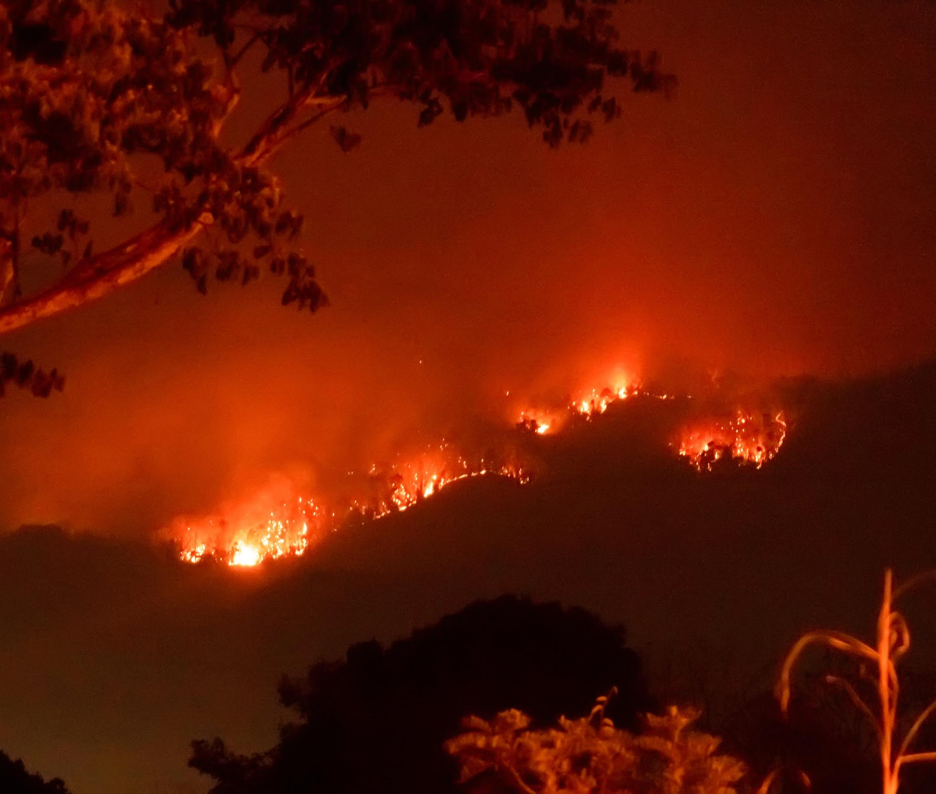

Hack for Sustainability
FIRE-O-DETECT

Slide 2
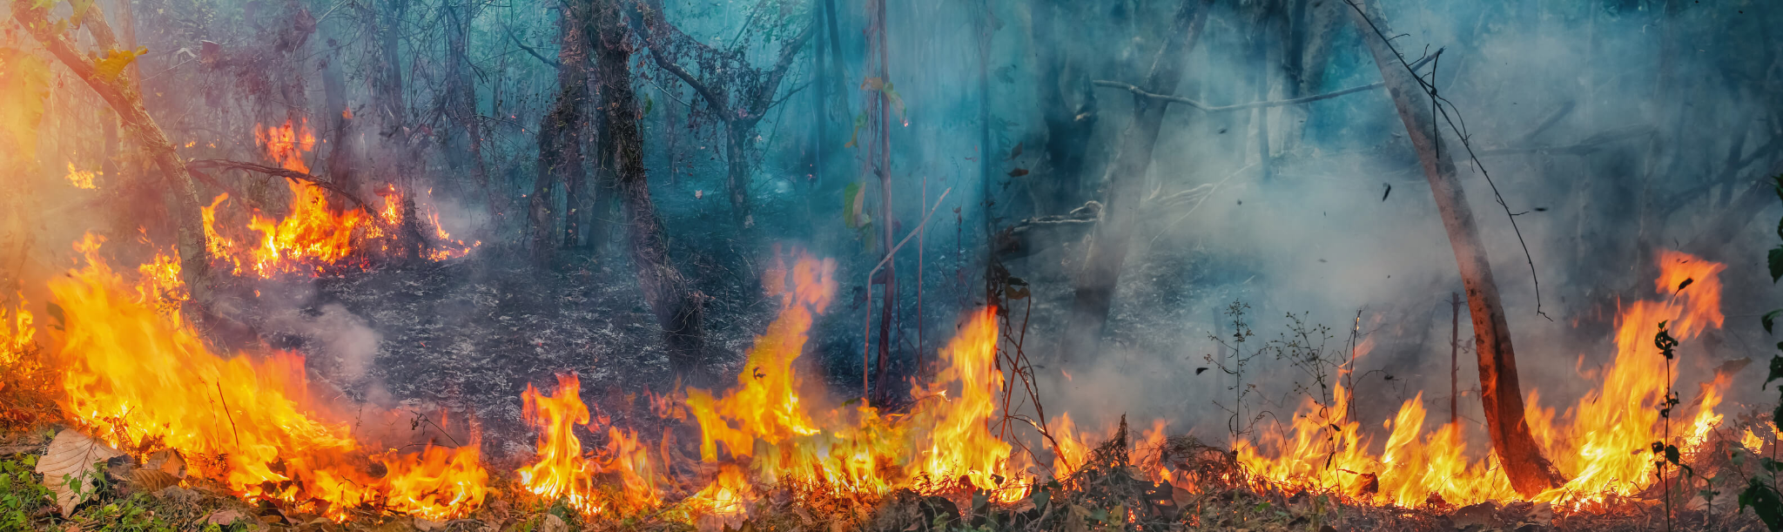
Problem Statement
Forest covers have been under threat for the past few years worldwide and there can be numerous undeniable reasons for it. The impacts of reduction in forest covers cannot be ignored any further.
Forest fires not only cause damage to the forest and its livelihood but also to the atmosphere releasing an abundance of harmful gases into the atmosphere which is harmful to human health. They ultimately lead to loss of property, crops, animals, resources and people.
Loss of vegetation further causes climate change, desertification, soil erosion, floods, increase in greenhouse gases in the atmosphere and also economic hardships to those small communities who are entirely dependent on the resources from forests.
The major problem with Forest Fires is that they are often detected too late and spread quickly.

Slide 3

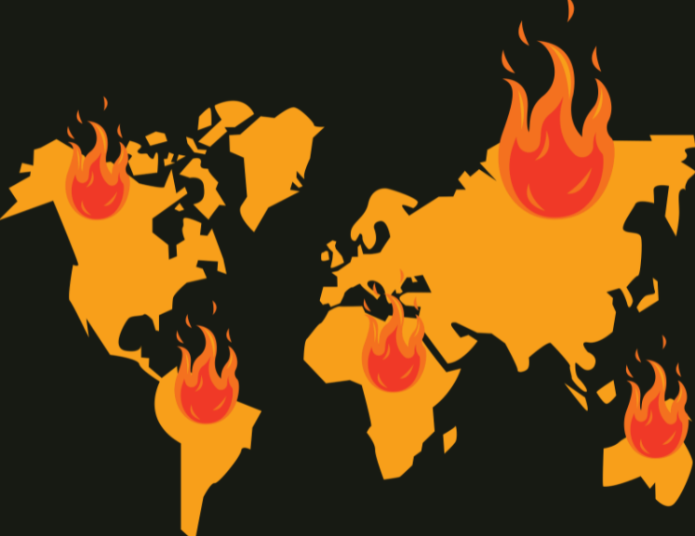
The Proposed Solution….
Predict the Threat at an Early Stage
Real-Time Monitoring
Easy to use Web Application
Identification of Forest Fires with an Alarming Situation.
No worries…
We have got you covered..

Slide 4


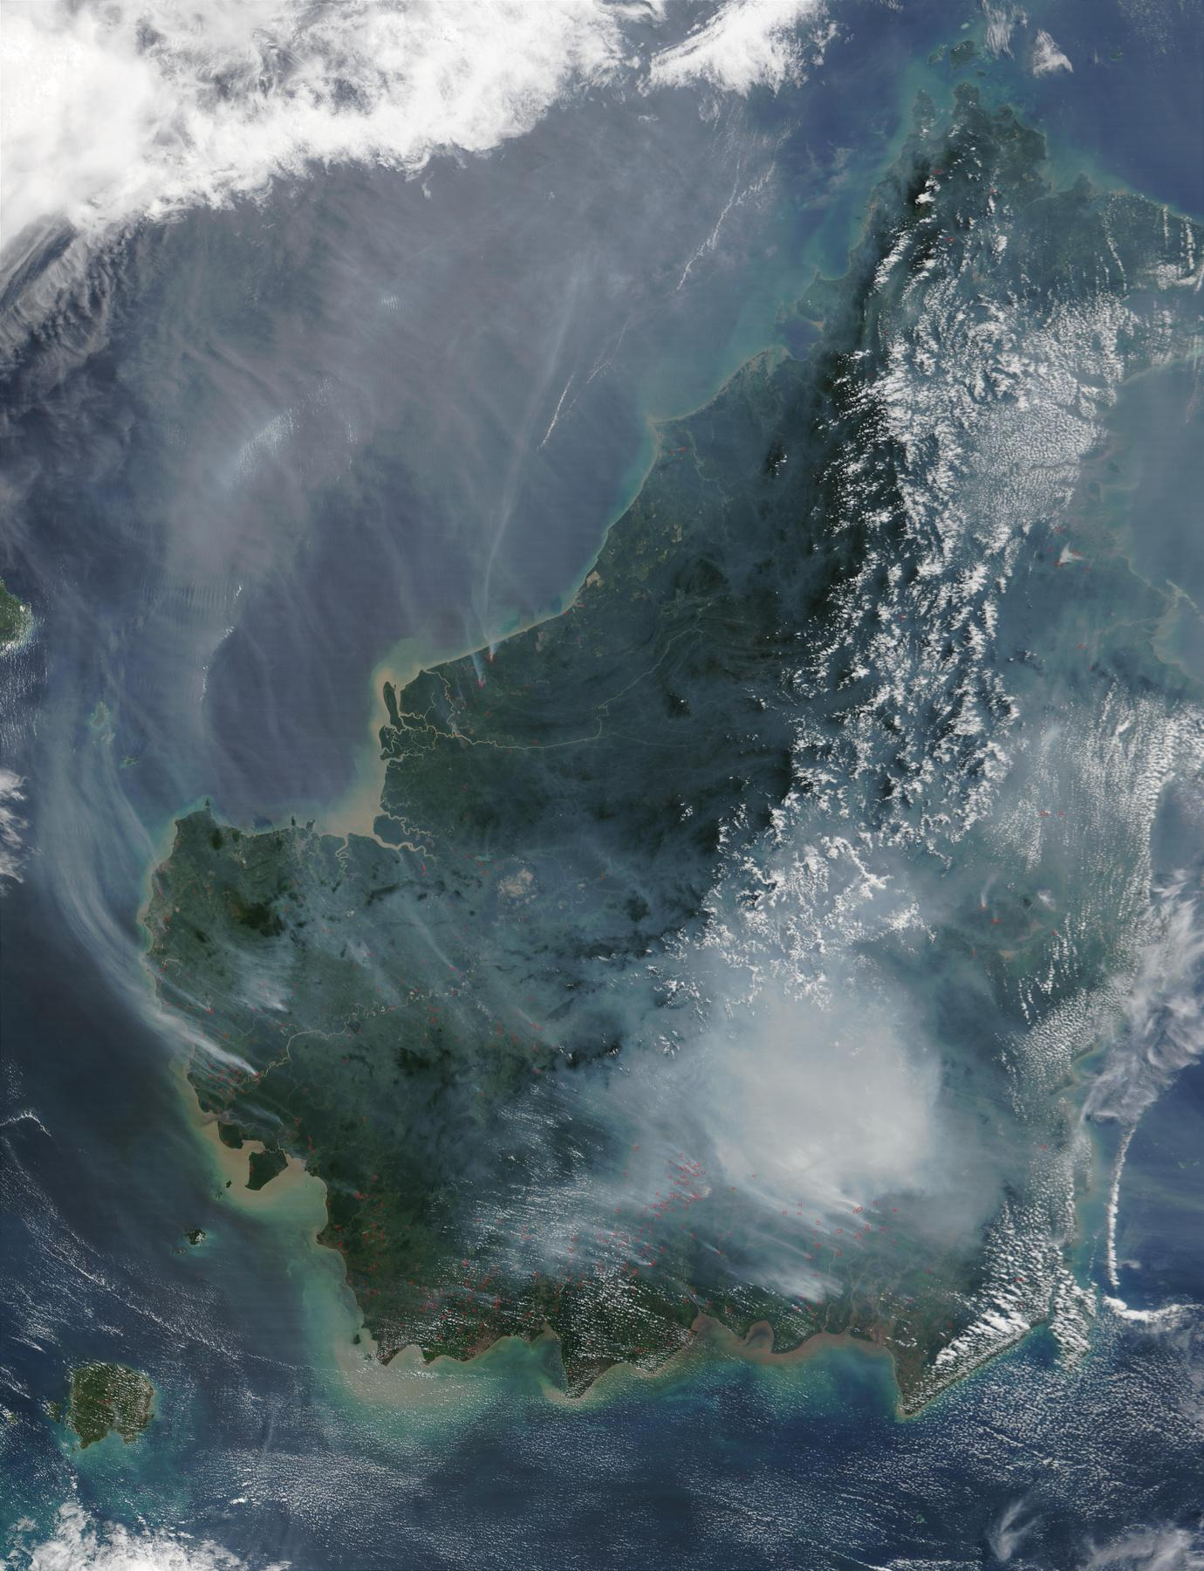

Project at a Glance:
Data stored in IBM Cloud
User Friendly monitoring App
Real Time Mesoscale Analysis using Google Earth Engine
Notifying the user in case of any fire detected.

Slide 5
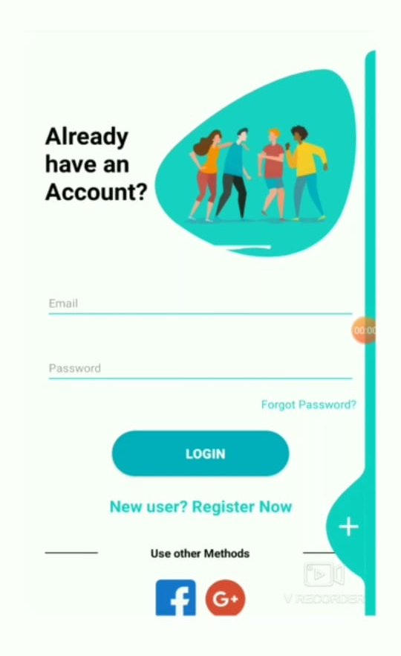

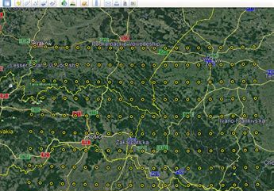
Salient Features:
User friendly UI with unique authentication for Coordinates Input.
Coordinate inputs for specific area recognition, prediction and detection.

Slide 6


Salient Features:
Real Time Mesoscale Analysis for Instantaneous Detection.
Alarm to Notify the concerned.

Slide 7
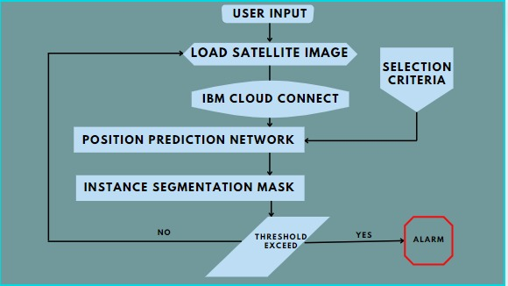
Flowchart:

Slide 8
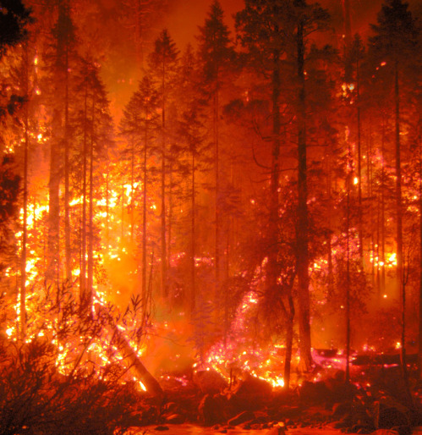

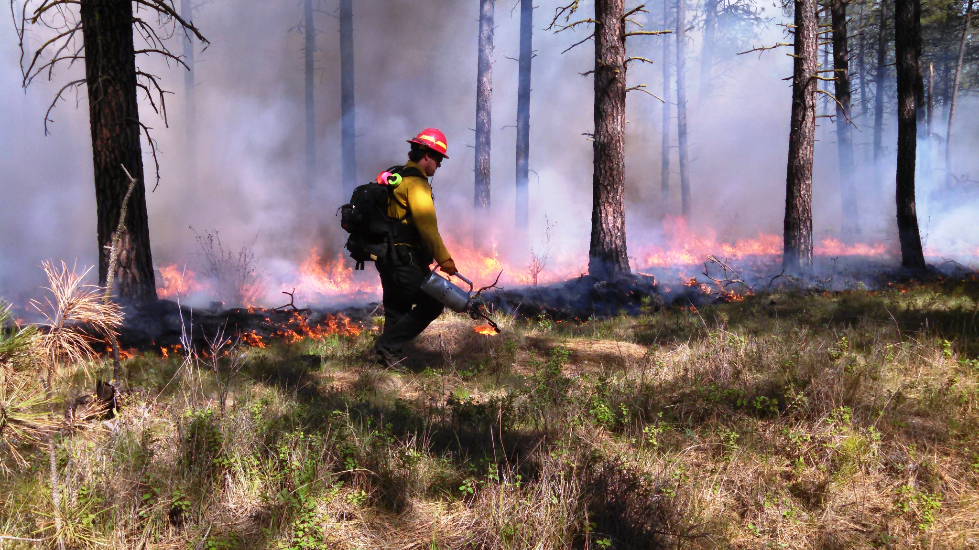
Future Prospect:
Automatic Notification to the Closest Fire Brigade Station.
Drone Based Automated Firefighters.

Slide 9
Project Expansion:
Deployment : Hosting on some platform -
Data Expansion : Real Time Mesoscale Analysis (RTMA) available only for North America.
Better Remote Sensing : Use of SAR Based Satellite Imagery for Improved Accuracy with Thermal Screening.

Slide 10
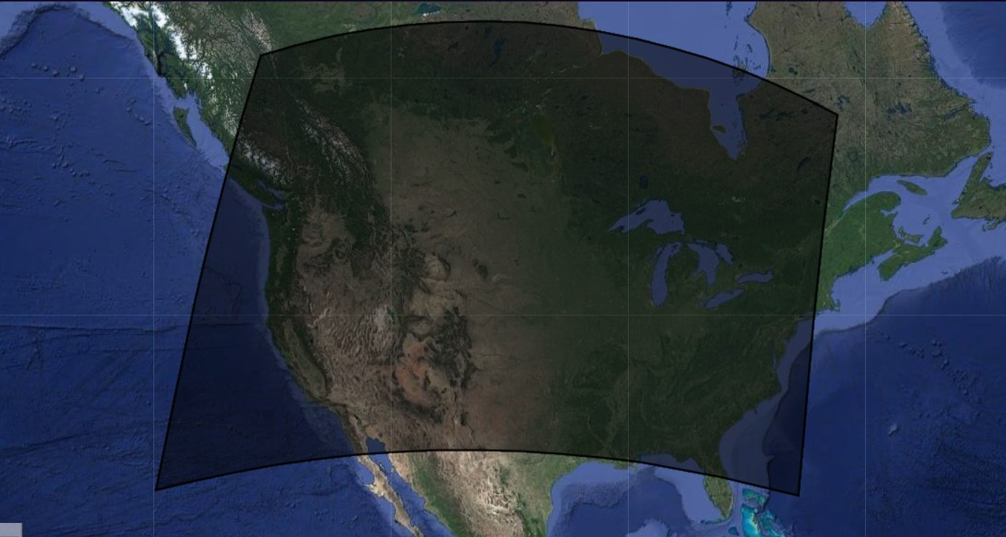
Selection of Region of Interest :

Slide 11
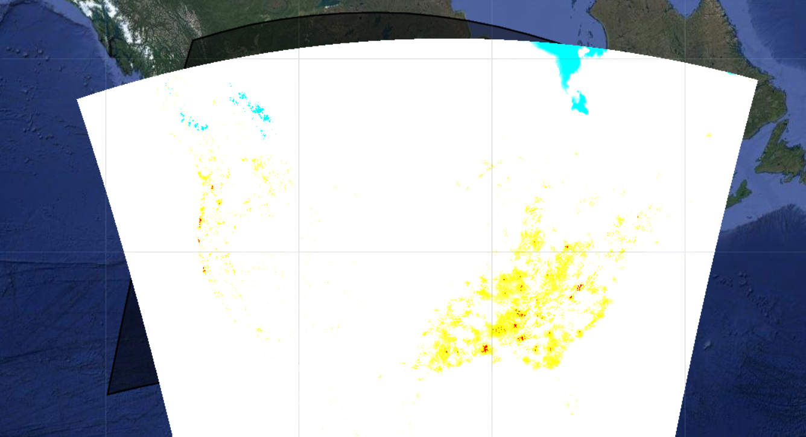
Real Time Mesoscale Analysis :

Slide 12
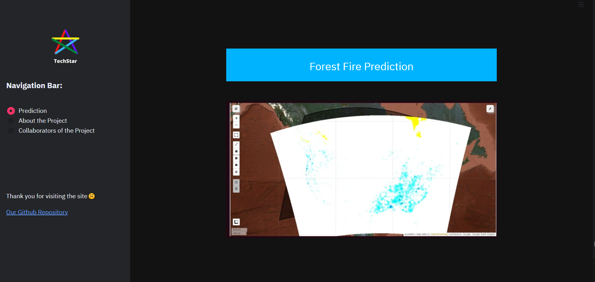
Web Application Demo :

Slide 13
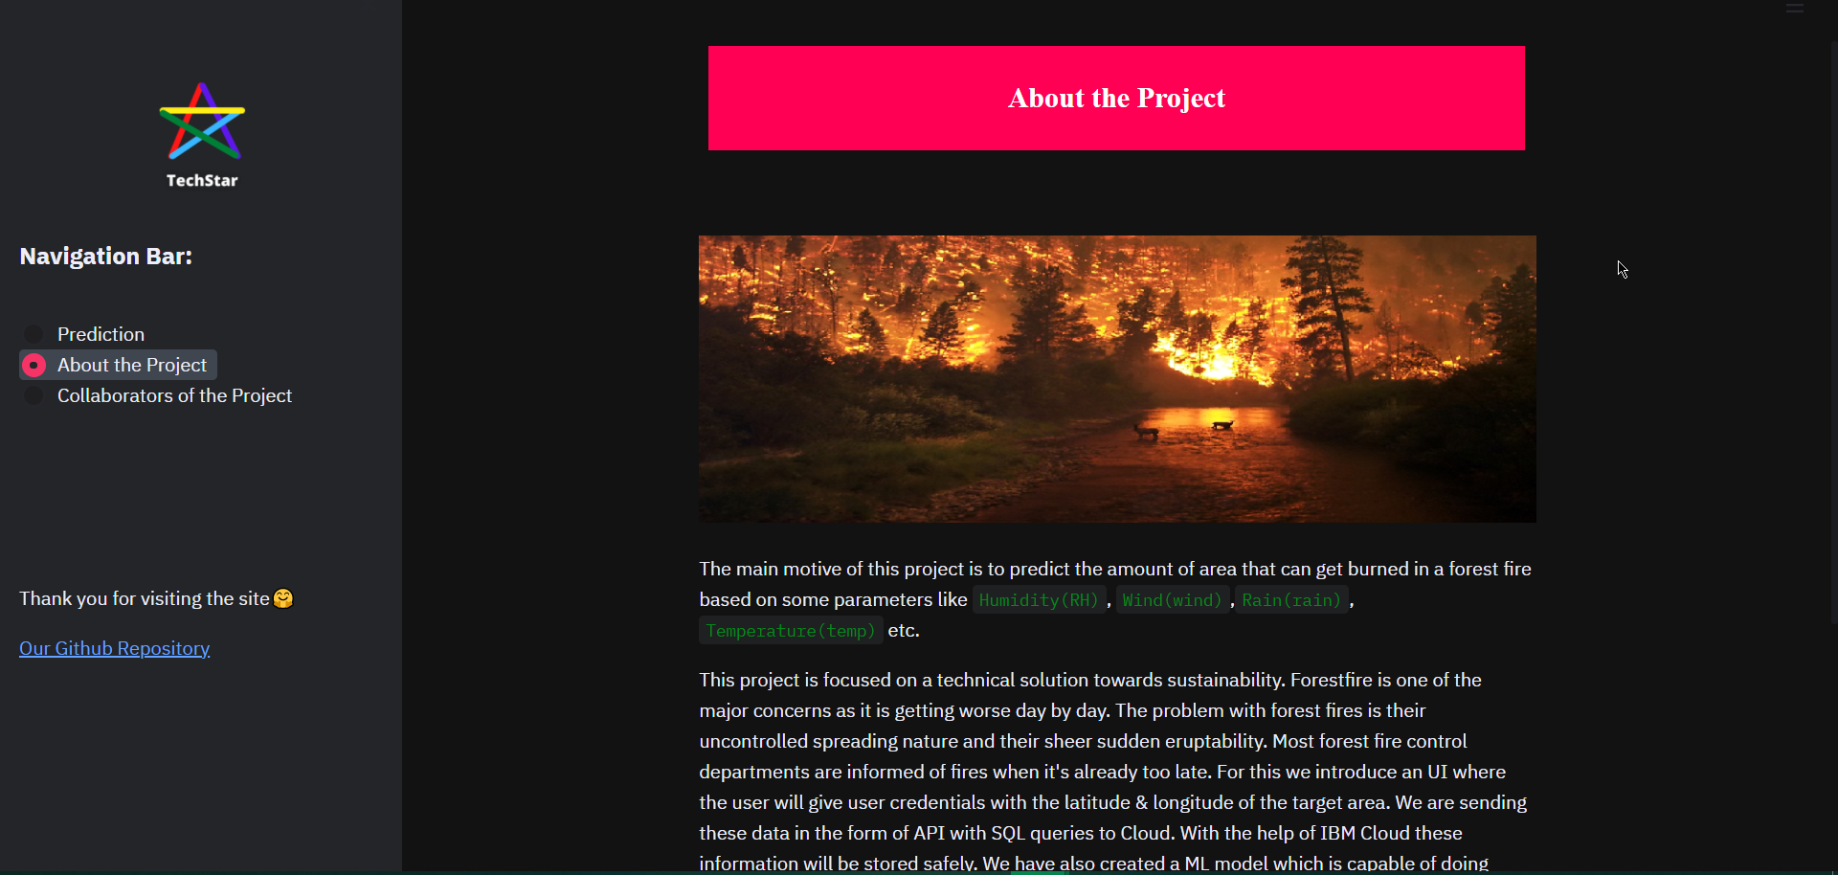
Web Application Demo :

Slide 14
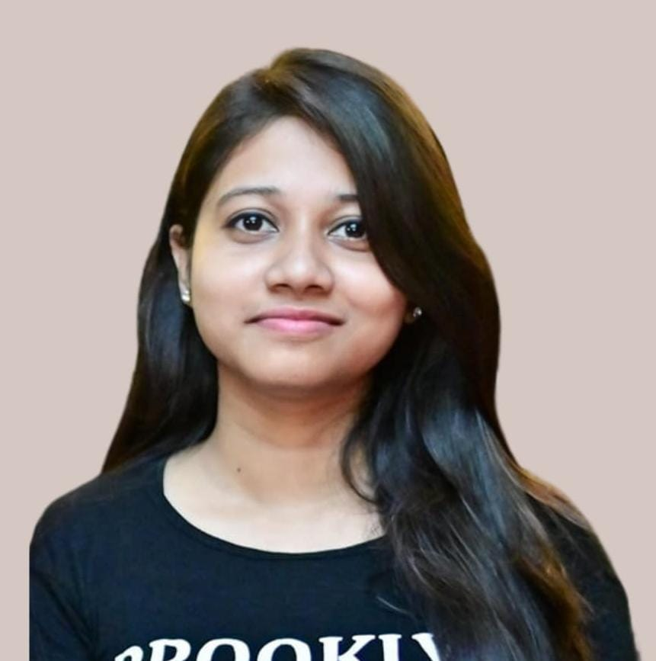

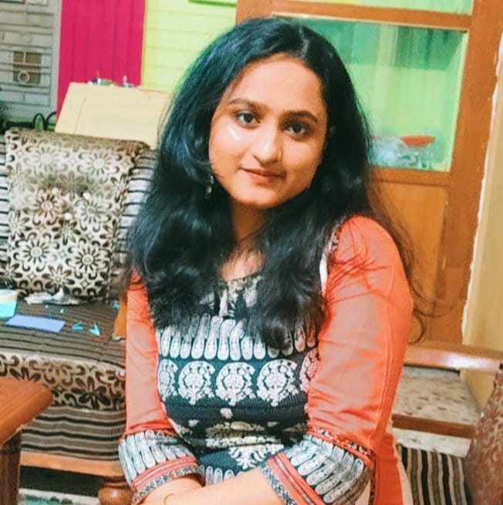
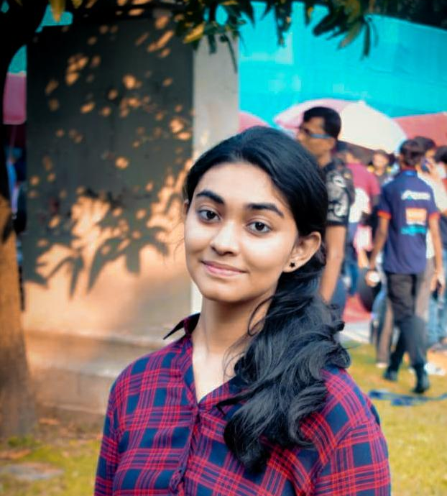
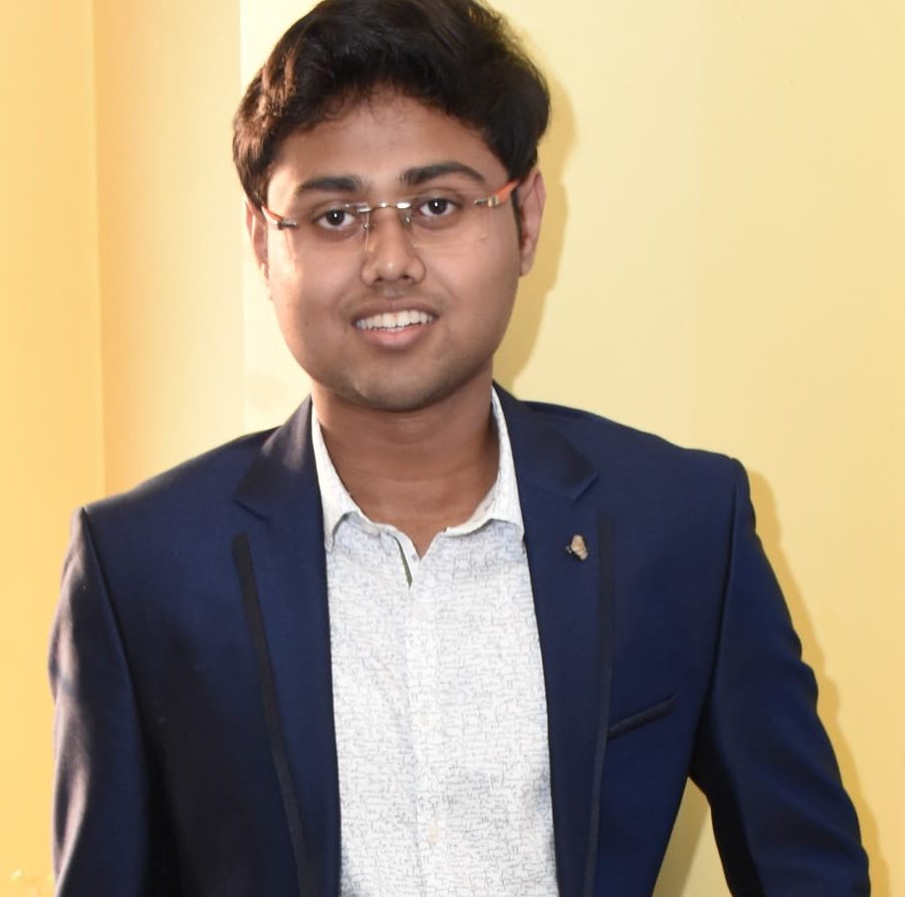
Our Team:
NAME | E-mail Id | Contact
SRIJANI DAS | srijani.das989@gmail.com | 7980898407
FARHAN HAI KHAN | njrfarhandasilva10@gmail.com | 7464027555
HADEEQA NISHAT | nhadeeqa@gmail.com | 7992401254
SAYANTI DUTTA | sayantidutta.dgp@gmail.com | 7699742314
ARBHIJAY SAHA | arbhijaysaha.net@gmail.com | 7319560074

Slide 15

Thank You!

